Slide 1
Self Organising Maps
Ananya Ramesh
Vigneshwar GD

Slide 2
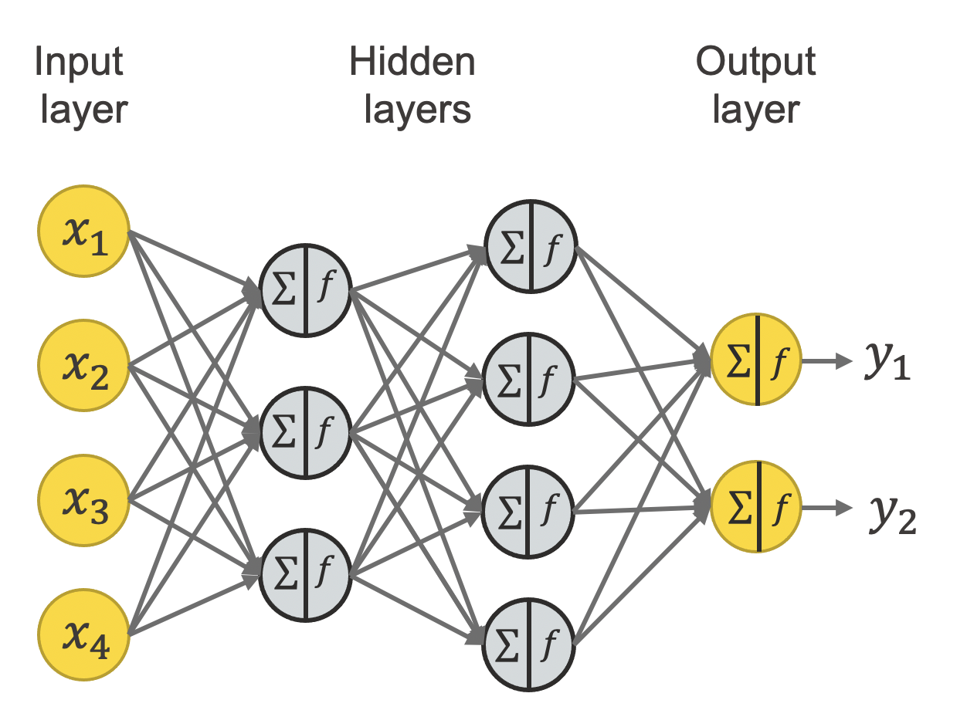
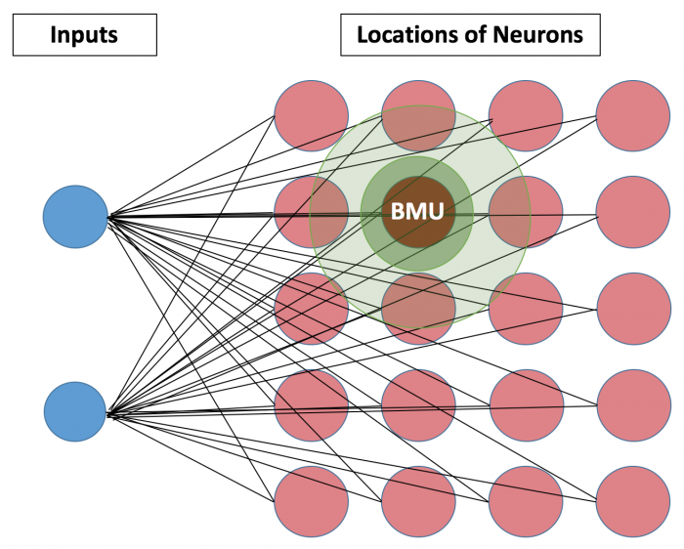
Idea behind Neural Network

Slide 3
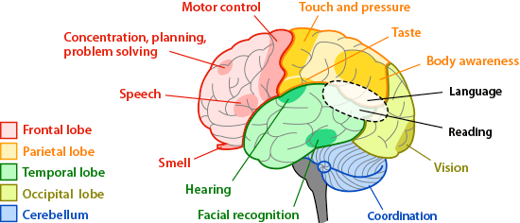
Motivation
Human brains topological nature

Slide 4
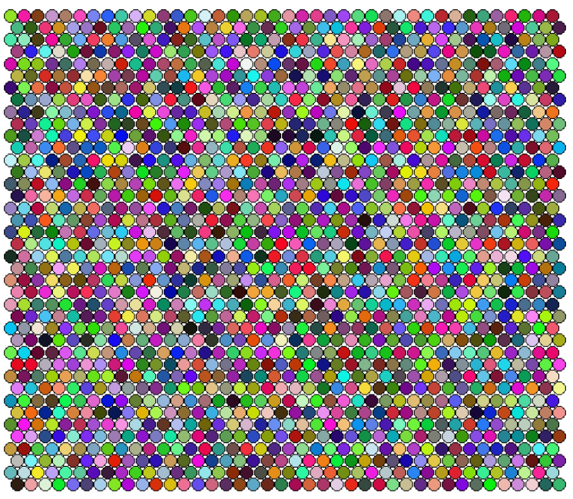
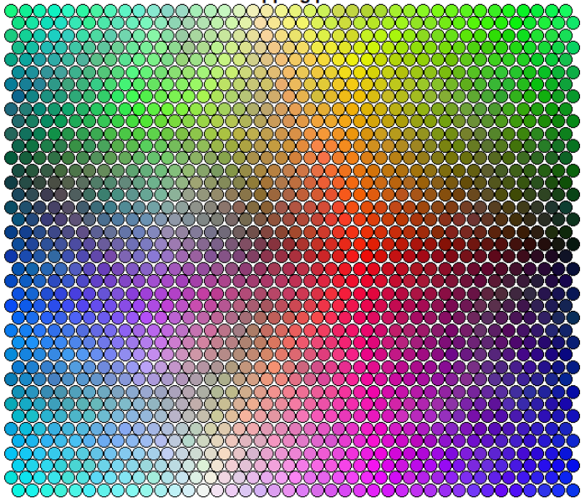
Output from SOM

Slide 5
Competitive Learning
Cooperation
Synaptic Adaptation
Neurons compete to win
Once it wins, the chance of winning with the same pattern increases
Winner takes all
Winning neuron determines spatial location
Neighbourhood neurons gets excitatory response
Far away neurons gets inhibitory response
Increases the excited neurons individual values of discriminant function

Slide 6
The Math

Slide 7
In essence
Initialize neural networks
Randomly select an input
Select the winning neuron using euclidean distance
Update neuron weights
Go back to 2 until done training

Slide 8
Principal Component Analysis - Motivation
Visualization of data is one of the most, if not the most, important step in the analysis of high-throughput data
A simple way of reducing the dimensionality of a data point is to project it onto a lower dimensional space.
Reference: https://medium.com/analytics-vidhya/dimensionality-reduction-principal-component-analysis-d1402b58feb1

Slide 9
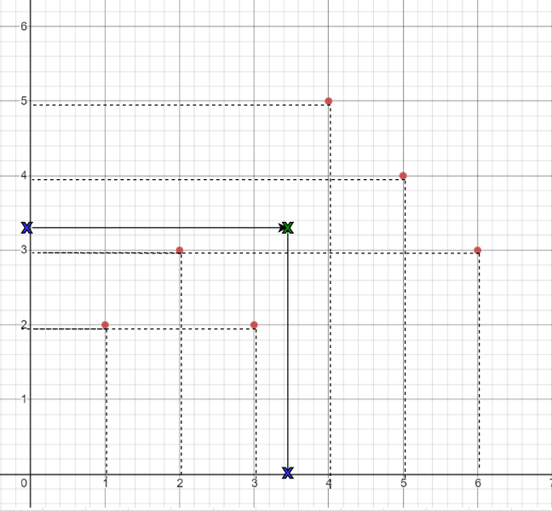
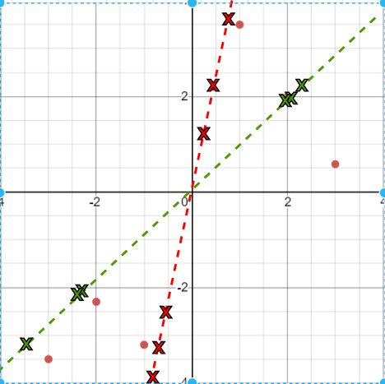
The Method
Project the data points on the x-axis and y-axis
Move the center to origin and find the best line that fits the data

Slide 10
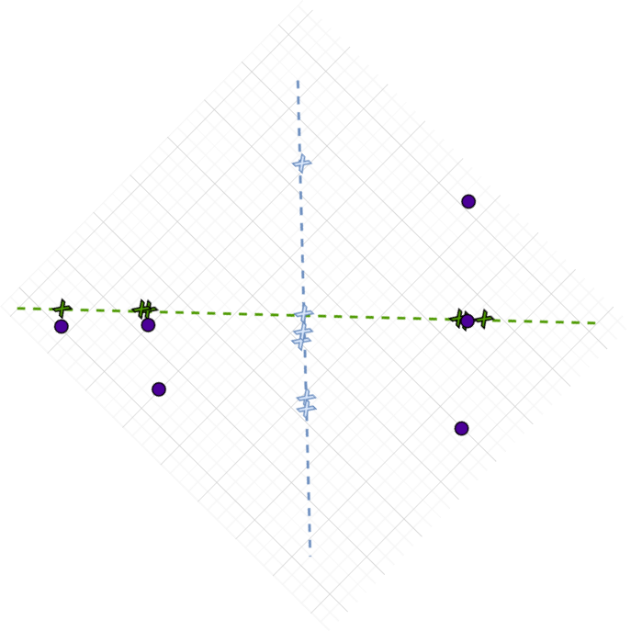
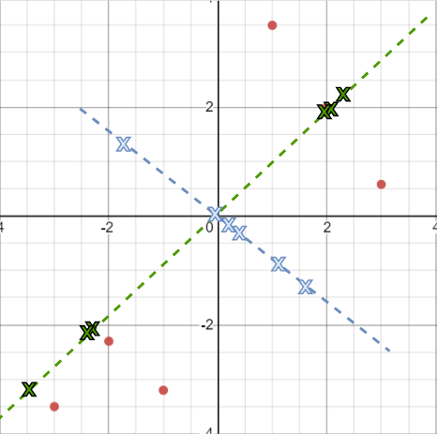
Draw a line perpendicular to PC1 and project the data points on to the second component(PC2)
Rotate the axis such that PC1 becomes the x-axis and PC2 becomes the y-axis

Slide 11
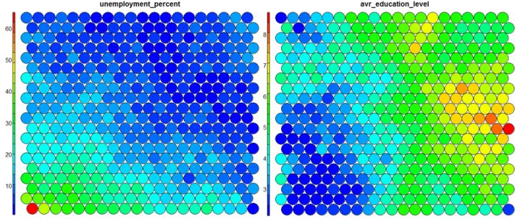
PCA vs SOM
The projection of variables based on similarity includes visual clustering information
Using the SOM visualisation, the detection of outliers and non-linearity becomes much easier
When more than three PCs may be needed to represent the data, even though the PCA loadings table is readable, the corresponding biplot would not be a human-readable-graphical representation anymore
Reference: Das G, Chattopadhyay M, Gupta S. A Comparison of Self-organising Maps and Principal Components Analysis. International Journal of Market Research. 2016;58(6):815-834. doi:10.2501/IJMR-2016-039
Image Reference: https://www.shanelynn.ie/self-organising-maps-for-customer-segmentation-using-r/

Slide 12
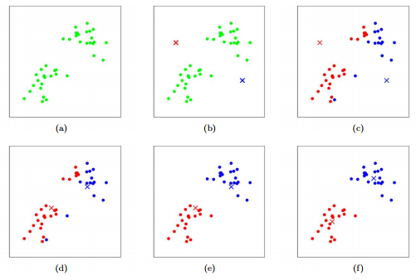
Clustering - k-means
K-means algorithm starts with k number of clusters with centroids, and then assign every data point randomly to any one of the cluster, after each iteration reassign every data point to the nearest cluster and update the centroid value. The algorithm stops when there are no more changes in the centroid values.
Reference: https://stanford.edu/~cpiech/cs221/handouts/kmeans.html

Slide 13
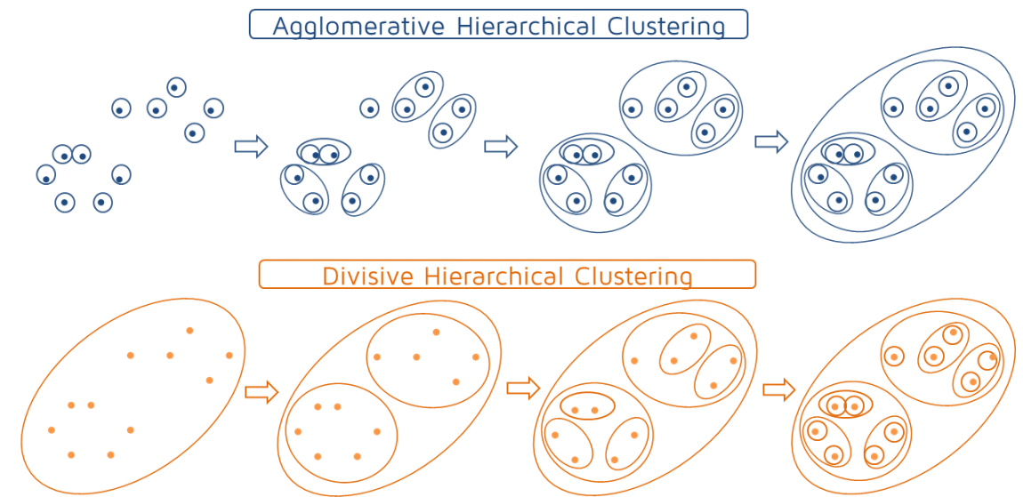
Clustering - Hierarchical Method
Bottom-Up
Starts with every data point assigned to its own cluster and after each iteration similar points are grouped into clusters.
Top-Down
Every data point is grouped into a single cluster at the beginning and as the hierarchy moves down, at every iteration a split is performed.
Reference: https://quantdare.com/hierarchical-clustering/

